Slide 1




CLOSE-READING of LINKED DATA
Anne Chardonnens, Ettore Rizza & Seth van Hooland
Notes:
Titre

Slide 2
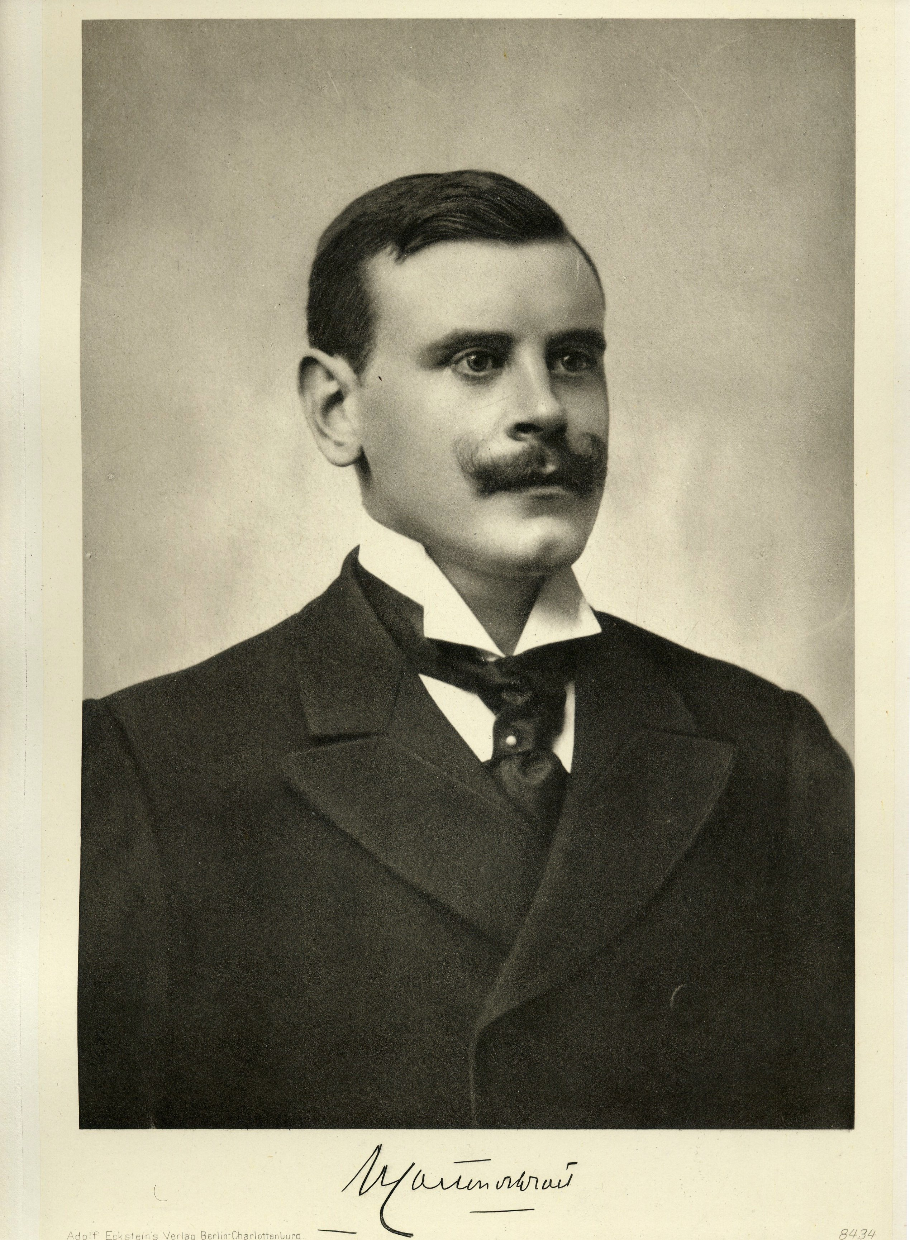
Henry CARTON DE WIARt

Slide 3
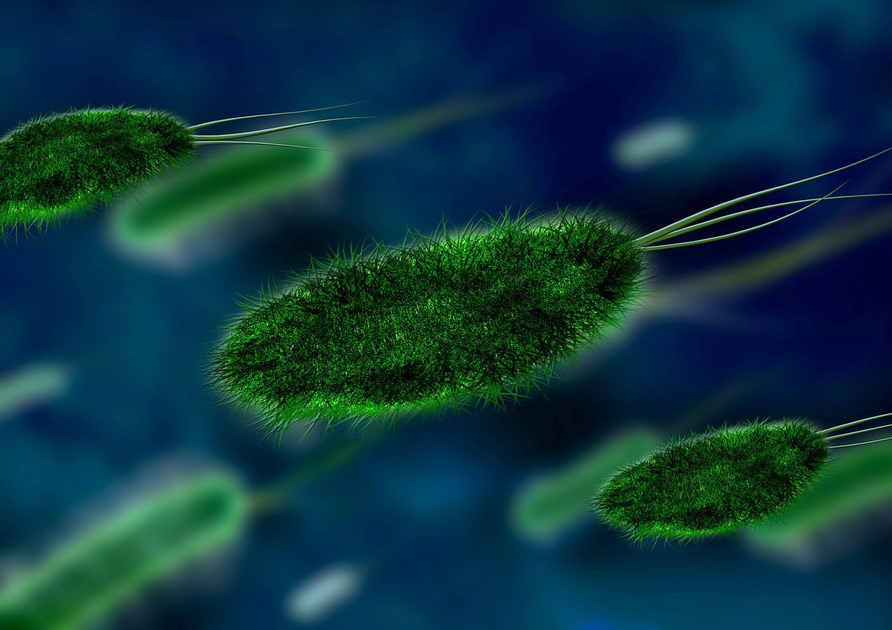

Slide 4
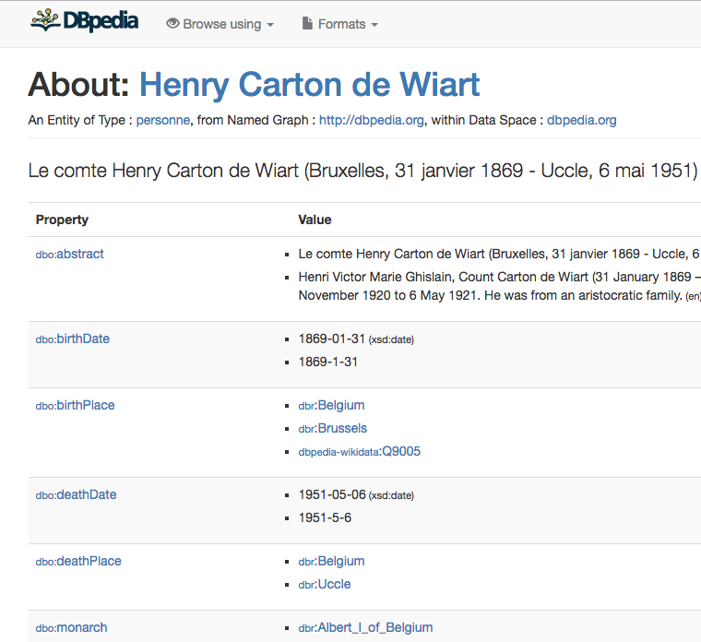
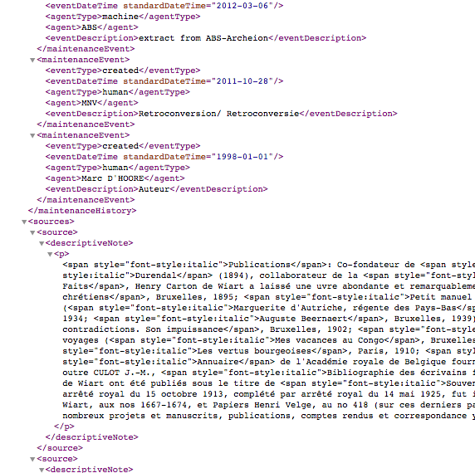
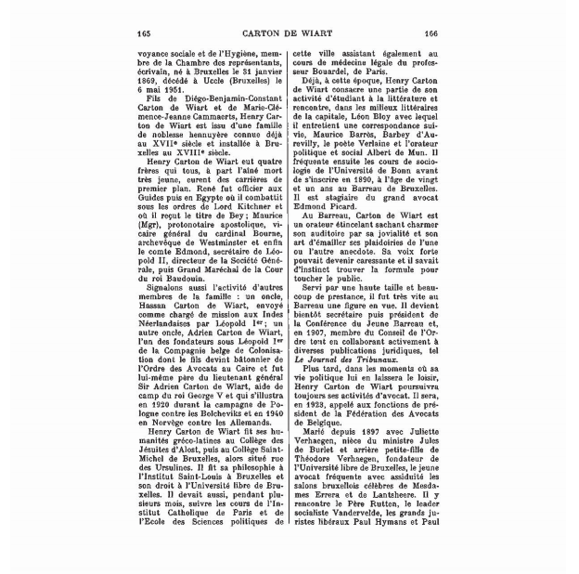
CONTinuum

Slide 5
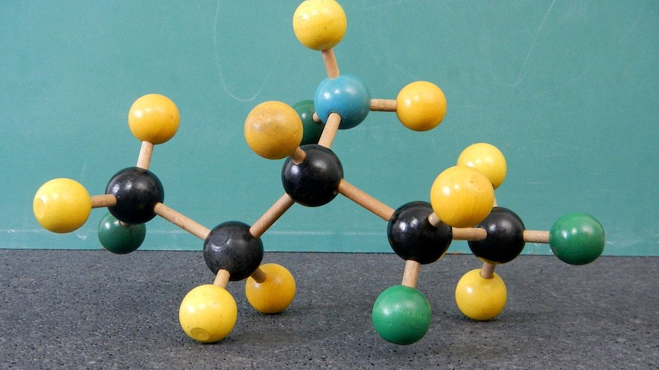
Image: https://www.pinterest.co.uk/pin/365636063482240503/

Slide 6
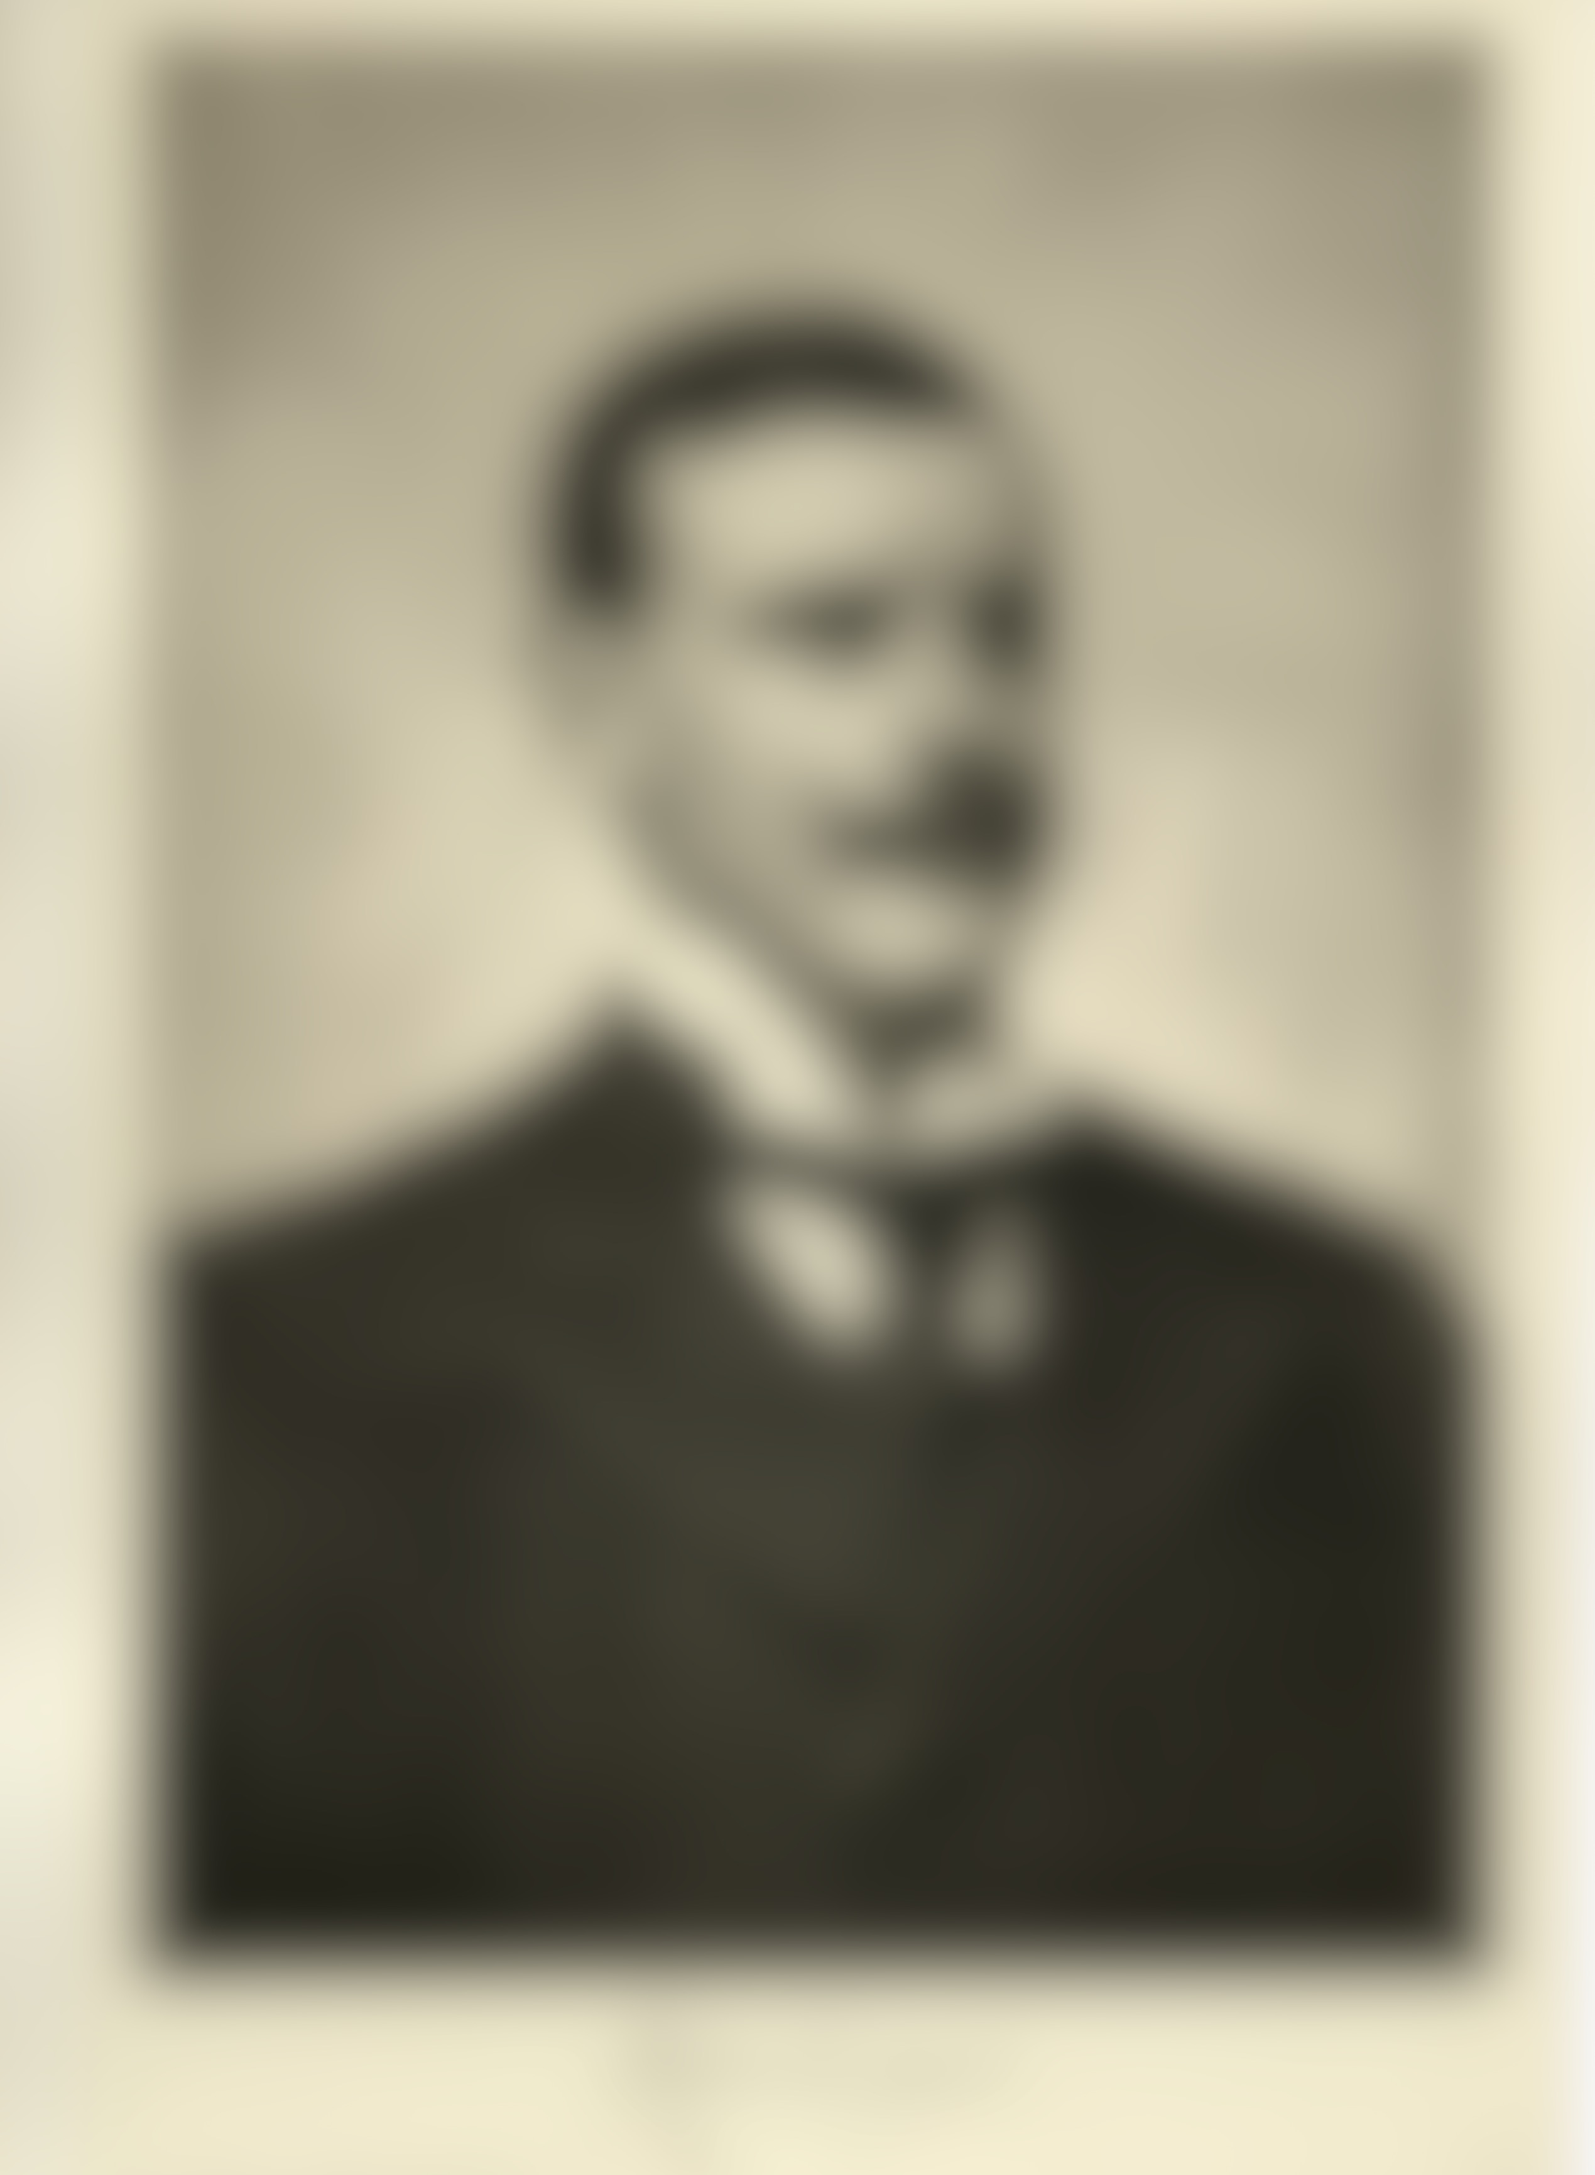
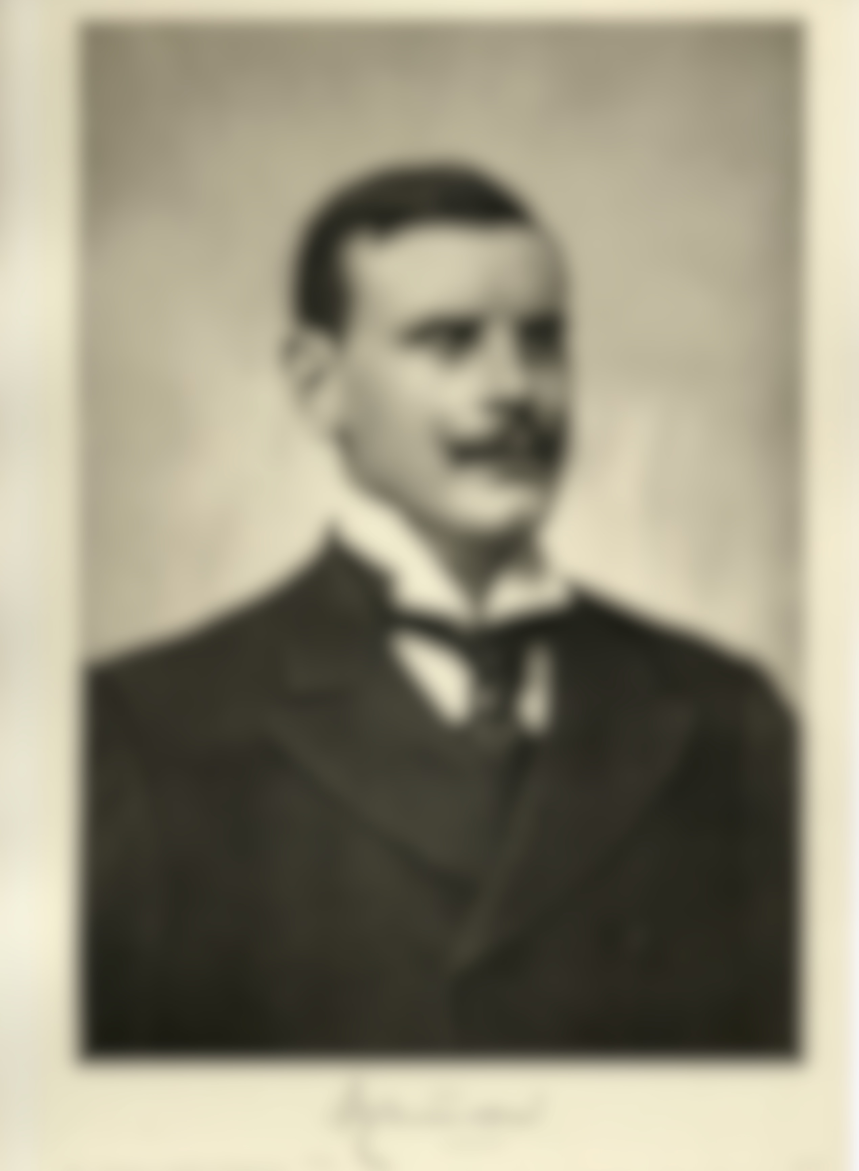
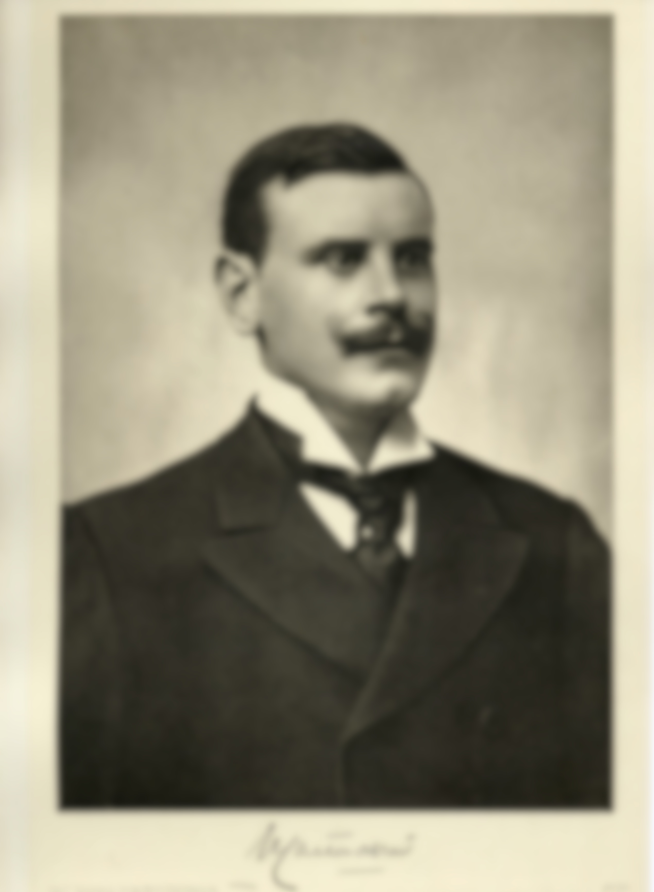

LIMITS

Slide 7


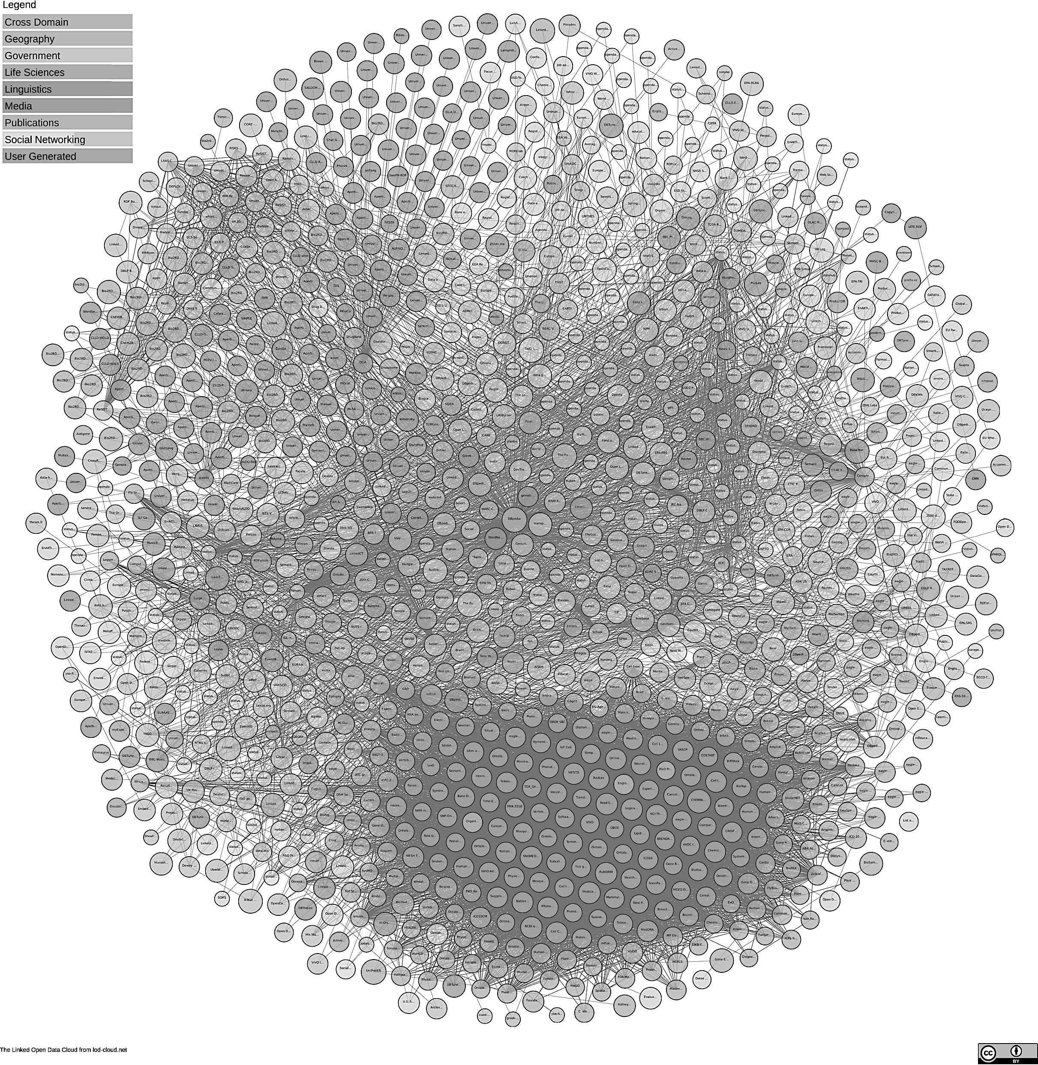


What IF…
Image (30.04.2018):https://lod-cloud.net/)

Slide 8
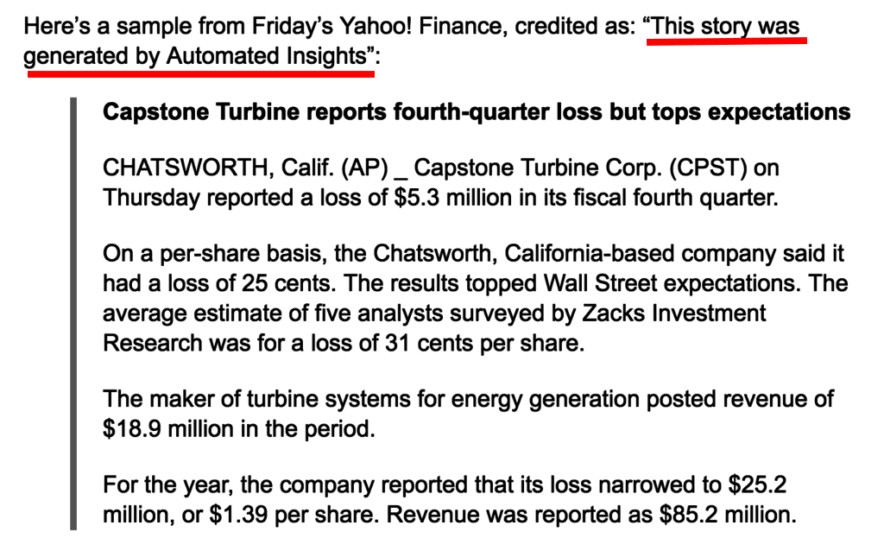
Robots can write short papers based on data
Image (30.04.2018):https://lod-cloud.net/)

Slide 9

Alex, the robot archivist
It can send queries on the web (API, SPARQL…)
It can read structured formats (XML, JSON, Turtle ...)
It can write a text from structured data

Slide 10
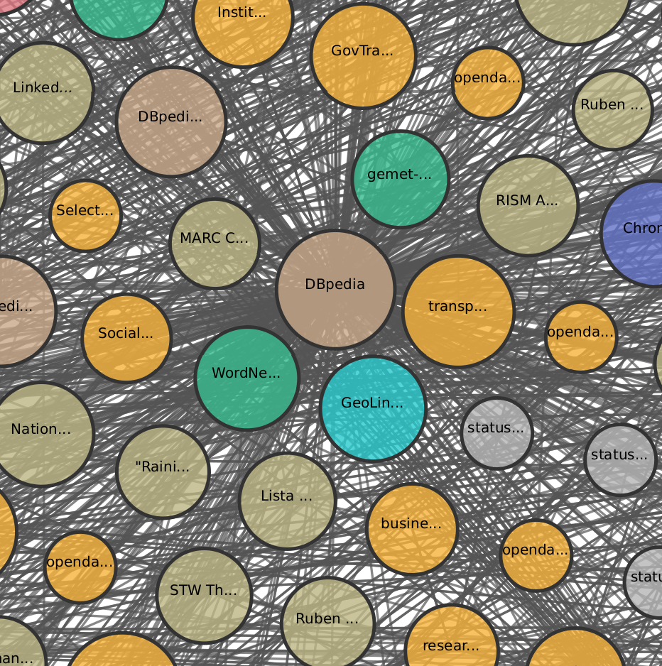
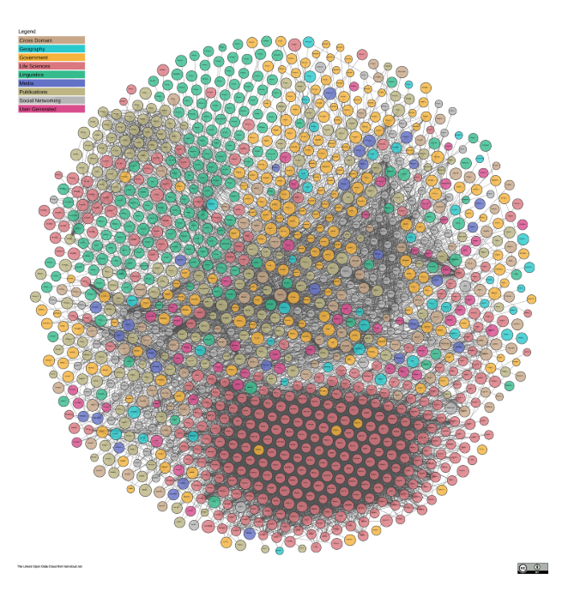
A robot walk in the Linked open data cloud
Image (30.04.2018):https://lod-cloud.net/)

Slide 11
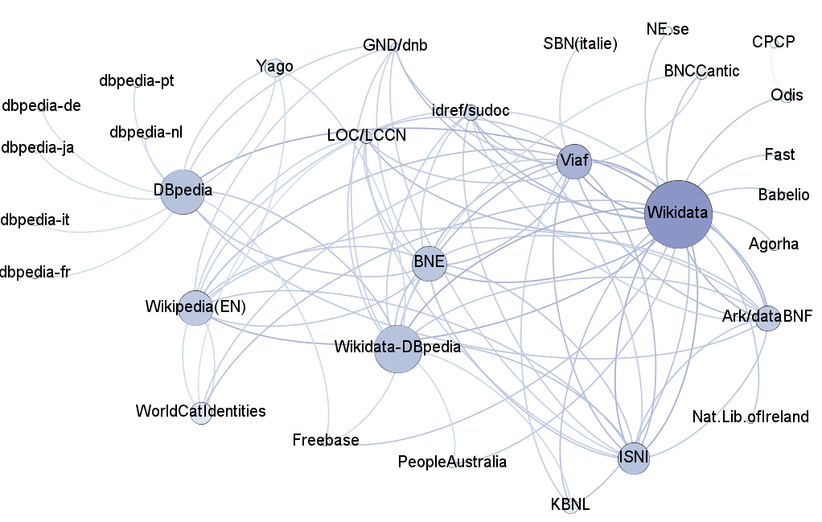
A robot walk in the LOD cloud
Image (30.04.2018):https://lod-cloud.net/)

Slide 12
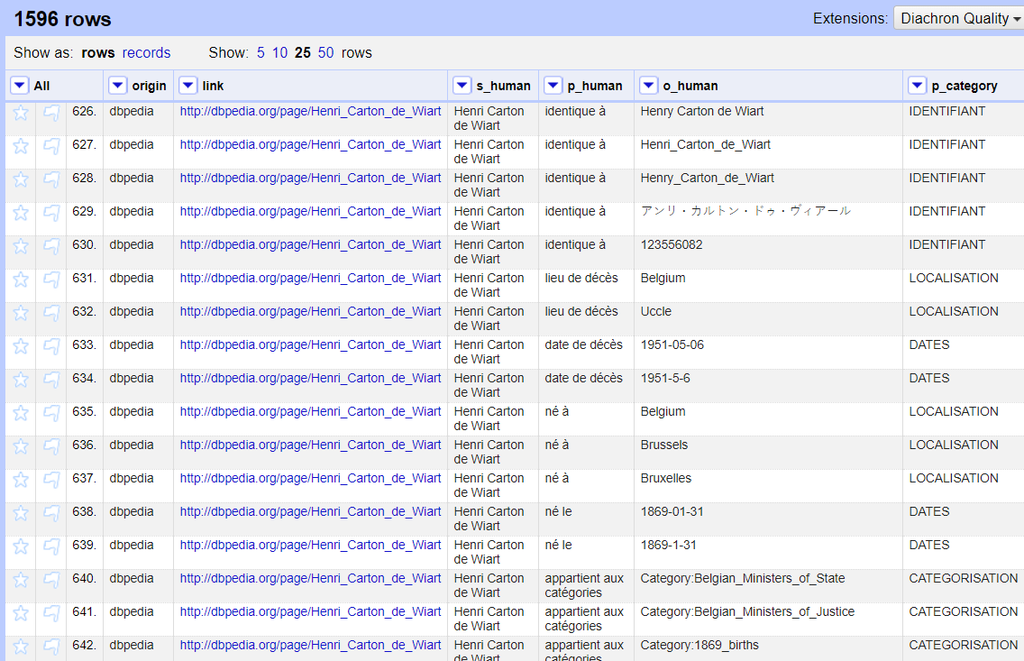
About 1500 triples often redundant
Image (30.04.2018):https://lod-cloud.net/)

Slide 13
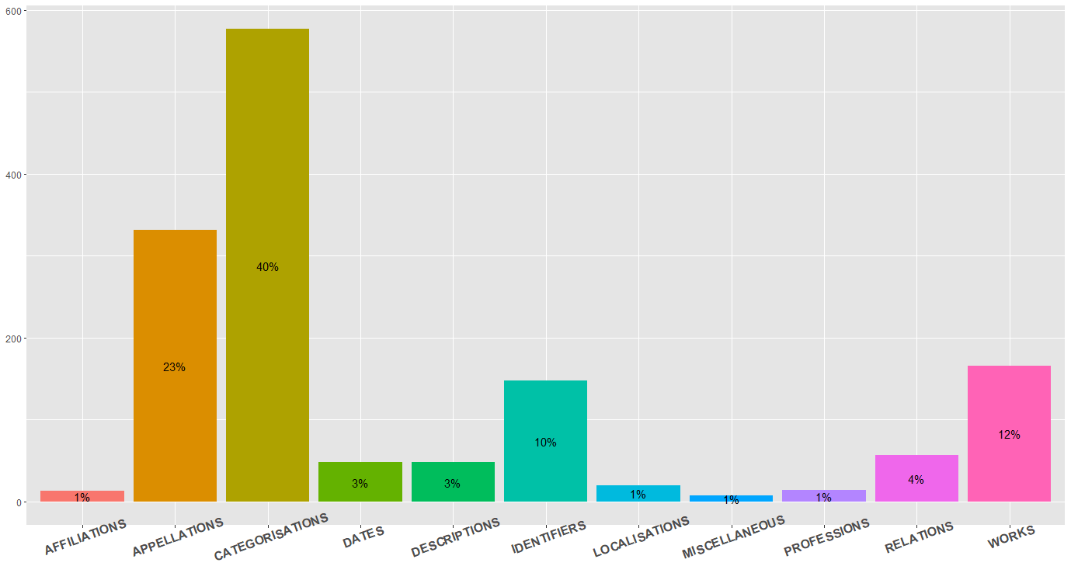
broad categories of RDF properties
Image (30.04.2018):https://lod-cloud.net/)

Slide 14
A “portrait-robot” based on Wikidata and Dbpedia EN-FR-NL
Henri or Henry Carton de Wiart (first name: Henry or Henri, name: Carton) is a French-speaking Belgian writer and politician, member of the Catholic Party or cdH. He was born on January 31, 1869 in Brussels and died on May 6, 1951 in Uccle. He served as Prime Minister of Belgium from 20 November 1920 to 16 December 1921, replacing Leon Delacroix. His successor was Georges Theunis.
He was a member of the House of Representatives (unknown period) and of the Royal Academy of French Language and Literature of Belgium (from August 9, 1920 to his death, where he was replaced by Hislaire Duesberg). His monarch was Albert I. He belonged to a coalition Catholic Party, PLP, POB. He lived in Rue de la Loi and his residence was "16".
He had as predecessors Albert Lilar, Hendrik Heyman, Henry Jaspar, Leon de Lantsheere, Leon Delacroix and Paul De Groote. He had as successors André_Dequae, Edmond_Rubbens, Emile_Vandervelde, Georges_Theunis, Ludovic_Moyersoen and Paul_.
He had some connection with Liege, Leopold III, Marcel Thiry, the Walloon Movement, Prosper Chicken, the Royal Question, the Wehrmacht, with several legislatures of the House of Representatives, with Albert Houtart, Gaston Eyskens, Adolf Daens, Jean Duvieusart, Edmond Carton de Wiart, with the Collège Saint-Michel, the moral classes, the circle Leo XIII ...
He is on the lists of Belgian Prime Ministers, Ministers of Justice, Interior, State, Education in French-speaking Belgium. He is subject of the categories former deputy, minister of state, Belgian ministers of justice, the interior, count, member of the Royal Academy, former deputy, writer of the nineteenth and twentieth century, French writer. He has written or collaborated on the following works: (...)
Image (30.04.2018):https://lod-cloud.net/)

